Slide 1


Conference Application
For American Society of Civil Engineering

Slide 2

Project Description and Motivation
Our project is to create an application for the upcoming American Society of Civil Engineers-ASCE conference 2019 at Saint Martin’s University. In this app students will be able to look up schedules, campus maps, room setting, and food options near as well as the university Cafeteria. It will also send out notifications prior to a session starting.

Slide 3

Process
Talking to the client and what they want
Collecting data
Making a plan
Designing the structure
Creating an ERD
Figuring out what language to use

Slide 4
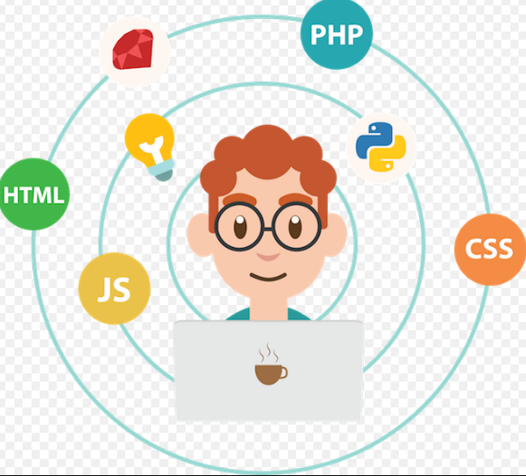
Coding and languages
HTML
To create the webpage
CSS
Style and organize the webpage
JavaScript
For features that require more complex coding
PHP
To connect the webpage to the database
SQL
To create a database for login and other necessary information

Slide 5
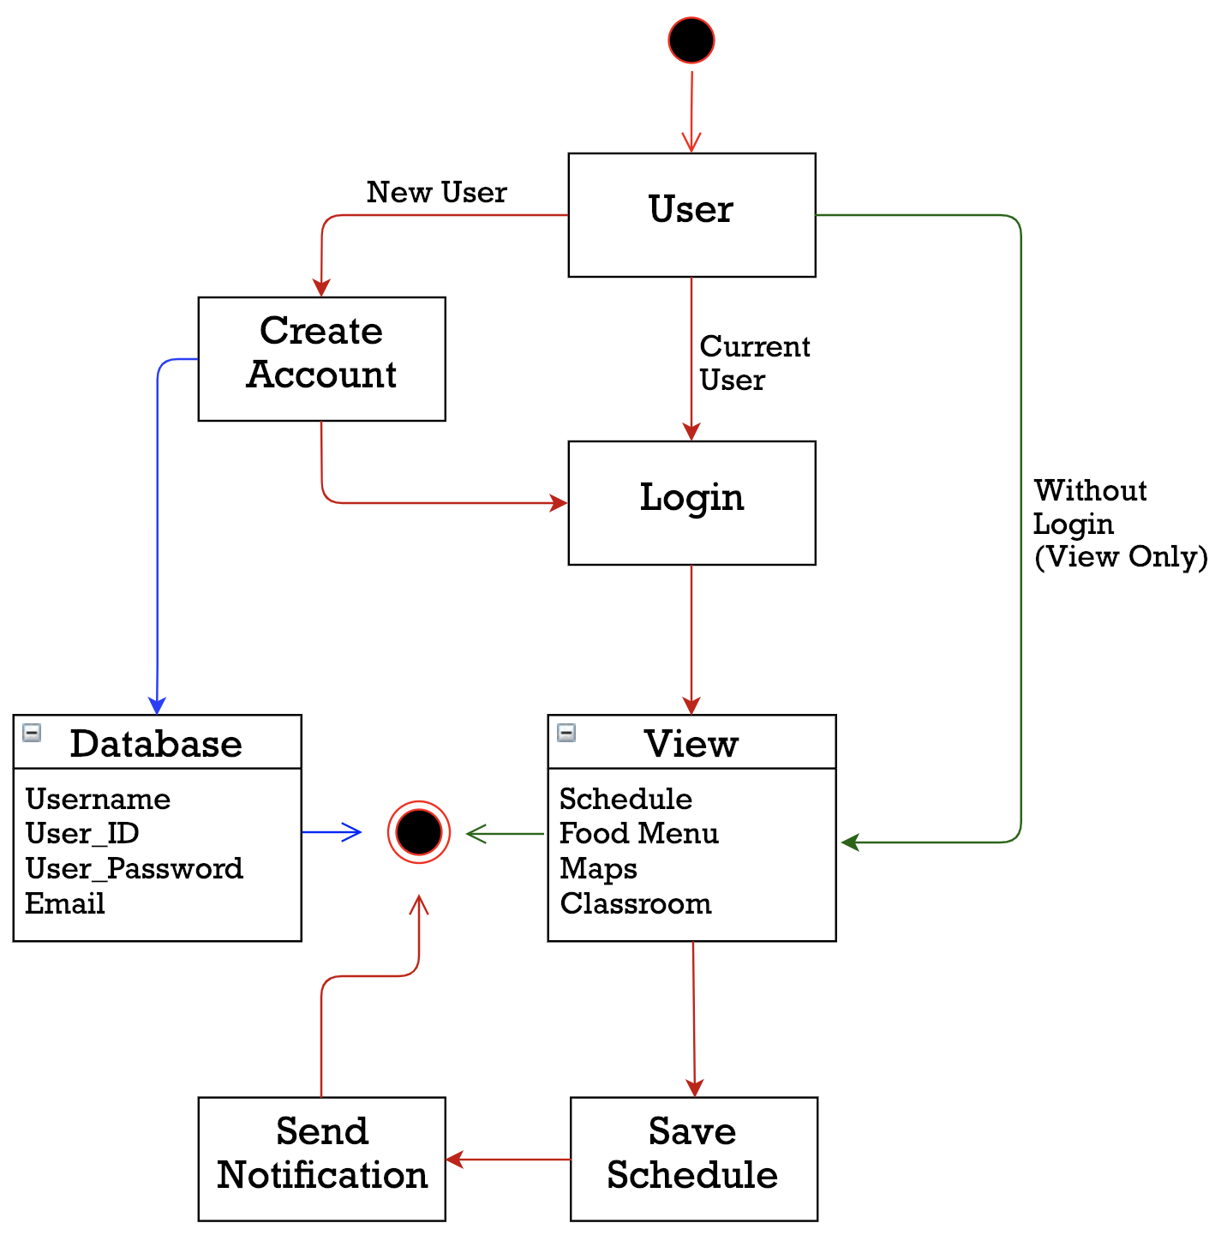

ERD-Entity Relationship Diagram
Creating a diagram of the project helps us visualize how everything is connected.
The arrows are color coded to help show the separate processes.

Slide 6

Data
Schedule
Campus Map
Food options
Room schedule
Contact list

Slide 7

Features
Send out notifications
Access to information with and without log in
Any devices friendly (including ios and Android)
Allows 700 users

Slide 8
Plan to Finish the Project
Code
Gather, organize, and style source code
Add
Add desired features
Mobile
Convert website to mobile application
Publish
Publish application to IOS on Android

Slide 9


Team:
Salma Mala and Amanda McMahon
Client:
Dr. Jill Walsh
Professor of the Engineering Department

Slide 10
